Slide 1
Nutrition as We Age
Session One: Components and Benefits of Healthy Eating
<Month X, 2019>
Brought to you by <Name / Team>
TH9049_0819

Slide 2
Three-part Course Objectives
1
Identify the components of a healthy, balanced diet. Session one
Describe how nutrition affects optimal aging. Session two
Explain the relationship between nutrition, exercise and stress management in maintaining overall health. Session three
Make health and nutrition decisions geared toward optimal aging. Session three
2
3
4

Slide 3
Activity
1
What can you identify as a perceived barrier to creating nutritional habit changes in your life?
Write your barrier on the white board.
Participate in group discussion on barriers.
2
3
(10 minutes)

Slide 4
Dietary Guidelines
Nutrition Guidelines for Adults
Make half of your plate fruits and vegetables.
Make half of your grains whole grains.
Choose low-fat and fat-free milk or yogurt.
Vary your protein routine.
Drink and eat less sodium, saturated fat, and added sugars.

Slide 5
Tips for Eating a Healthy Diet
Eat the colors of the rainbow.
Aim for variety.
Decrease the amount of fast food you eat.
Eat in moderation.
Follow the 80/20 rule.
Be consistent.
80/20

Slide 6
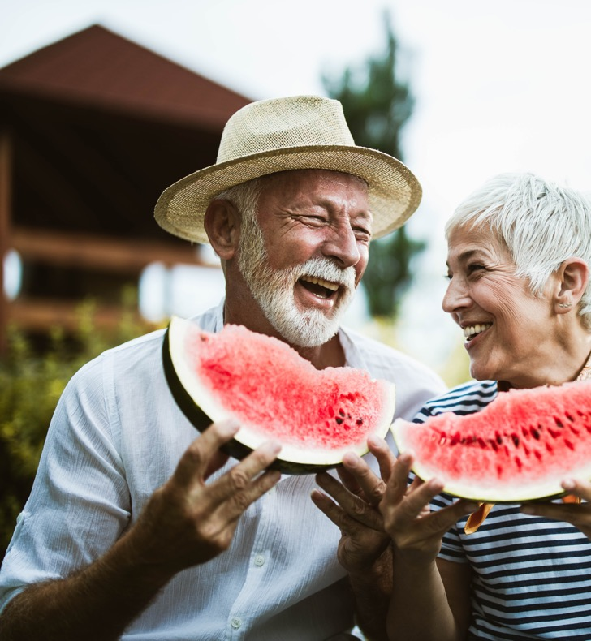
Benefits of Healthy Eating
Increased energy levels
Improved sleep
Improved cognitive function
Improved body composition (muscle mass, bone density)
Lowered risk of disease and illness
Overall increased quality of life and happiness

Slide 7
Activity
1
In writing, describe 2 to 3 typical meals for you.
Make adjustments to those meals using the MyPlate meal guidelines.
Participate in group discussion on how to adapt meals to MyPlate.
2
3
(10 minutes)

Slide 8
Activity
Conclusion
What are the components of a healthy, balanced diet?
What are some tips to eating a healthier diet?
What are some of the benefits of healthy eating?
Remember the perceived barrier you chose earlier. We will discuss that next week.

Slide 9
End of Session 1

Slide 10
Nutrition as We Age
Session Two: Nutrition and Aging
<Month X, 2019>
Brought to you by <Name / Team>
TH9049_0819

Slide 11
Course Objectives
1
Identify the components of a healthy, balanced diet. Session one
Describe how nutrition affects optimal aging. Session two
Explain the relationship between nutrition, exercise and stress management in maintaining overall health. Session three
Make health and nutrition decisions geared toward optimal aging. Session three
2
3
4

Slide 12
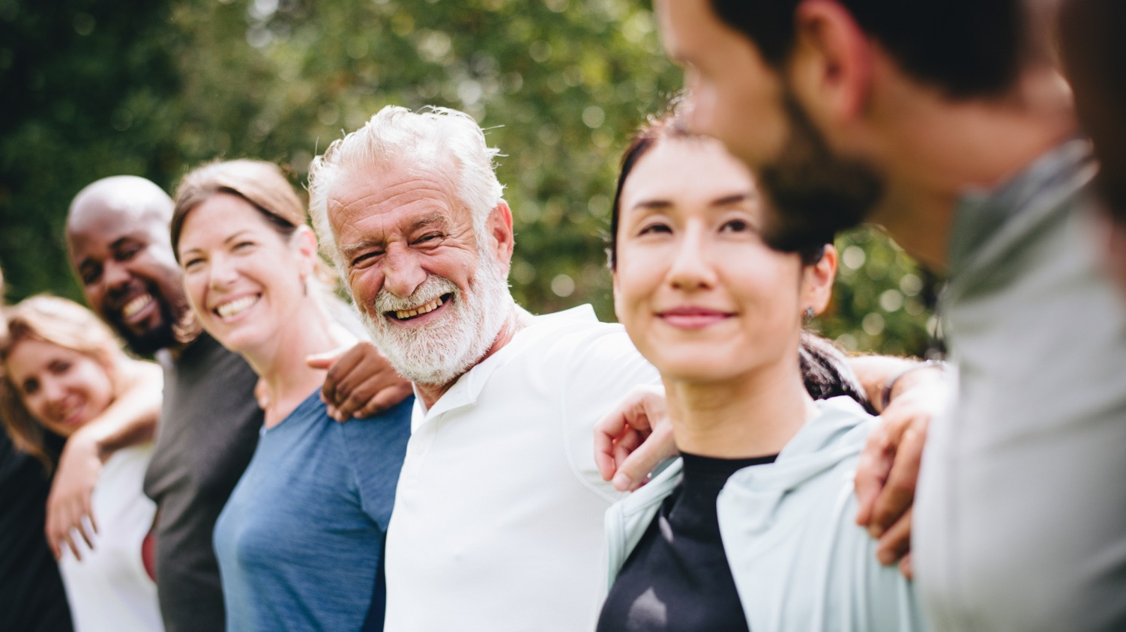
Activity
What Happens as You Age
Age-related changes
We can improve our quality of life through lifestyle changes.
Learn how to keep up with a changing body with changing needs.
Behavioral
Cognitive
Physical
Orthopedic
Digestive
Notes:
Do we want activity slides in the PowerPoint or not

Slide 13
Nutrition and Aging
How nutrition impacts the aging process
Important nutrients
Potassium
Calcium
Vitamin D
Vitamin B12
Dietary Fiber

Slide 14
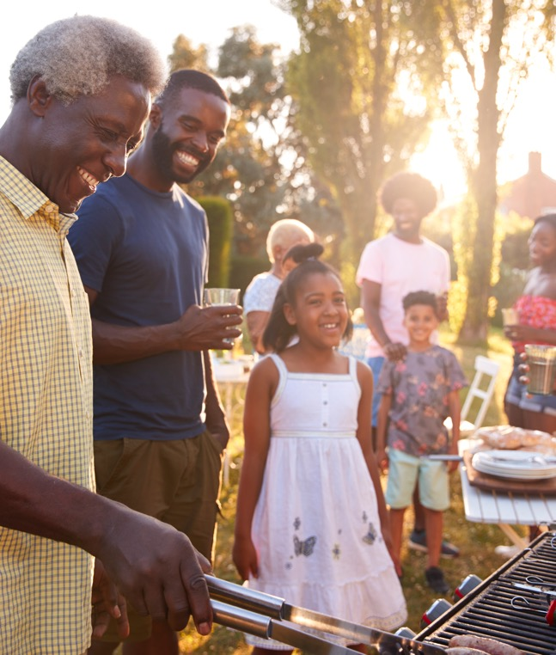
Illness and Disease Prevention
“You are what you eat.”
We can significantly reduce the risk of disease and illness by being aware of what we put into our bodies and taking care of ourselves.
Major factors impacting our health
Nutrition
Physical activity levels
Genetics
Tobacco, alcohol, substance abuse

Slide 15
Activity
1
Review the barriers you identified in session one.
Choose 1 barrier as an area of improvement.
Set small, specific goals to overcome this barrier and improve your nutritional habits. Write these down.
Discuss your goals with the group.
2
3
4
(10 minutes)

Slide 16
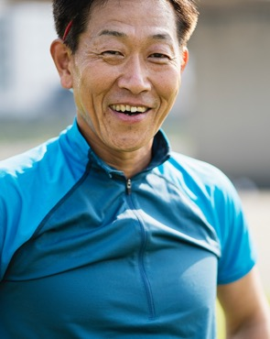
Activity
Conclusion
How does nutrition affect optimal aging?
Remember your goals for removing your healthy eating barrier
What are some major factors impacting illness and disease?
What are some things that happen to us as we age?

Slide 17
End of Session Two

Slide 18
Nutrition as We Age
Session Three: Longevity and Maintenance
<Month X, 2019>
Brought to you by <Name / Team>
TH9049_0819

Slide 19
Course Objectives
1
Identify the components of a healthy, balanced diet. Session one
Describe how nutrition affects optimal aging. Session two
Explain the relationship between nutrition, exercise and stress management in maintaining overall health. Session three
Make health and nutrition decisions geared toward optimal aging. Session three
2
3
4

Slide 20
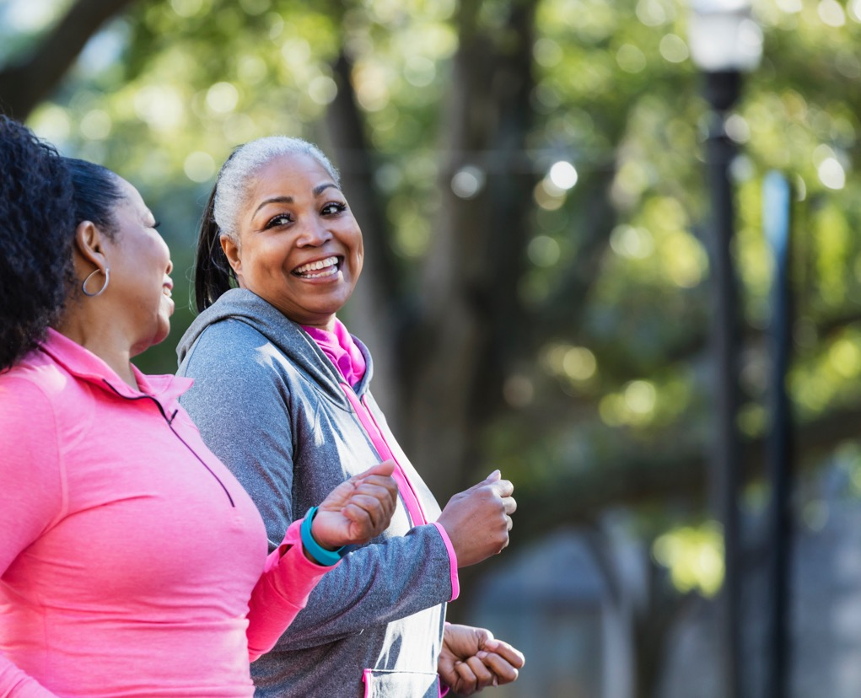
Nutrition, Physical Activity and Stress
Nutrition + physical activity + reduced stress = improved overall health and longevity
150
Recommended amount of physical activity: At least 150 minutes per week
Proper stress management
Physical activity: Walking, yoga, tai chi, lifting weights
Vitamin D exposure by getting out in nature
Stress management: Mindfulness, meditation, social activities

Slide 21
Resources (Optional slide based on participants)
MyPlate.gov
SilverSneakers.com
Easy ways to get involved through SilverSneakers®
Fitness and Community Centers
Group Fitness and Community Classes
SilverSneakers Go™
SilverSneakers On-Demand™
Community Yoga Classes
SilverSneakers On-Demand Mind and Body
SilverSneakers Go Guided Meditation
SilverSneakers EnerChi

Slide 22
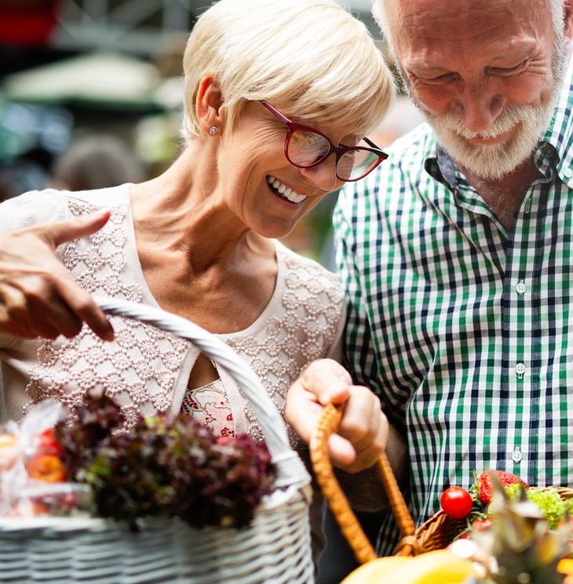
Maintaining Our Healthy Habits
1
2
3
Identify barriers.
Outline steps to overcome barriers.
Small and attainable actions lead to gradual long-term change.
4
5
Rely on social support.
Focus on habits vs. results.

Slide 23
Activity
Conclusion
What are the components of a healthy, balanced diet?
How does nutrition affect optimal aging?
Remember the relationship among nutrition, exercise, and stress management in maintaining overall health.
Make health and nutrition decisions geared toward optimal aging.

Slide 24
Activity
Conclusion
What is the recommended amount of physical activity each week?
Make health and nutrition decisions geared toward optimal aging.
Remember the relationship among nutrition, exercise, and stress management in maintaining overall health.
How are you doing on your goals from last week?

Slide 25
Optional more info, contact info, etc.

Slide 26
Resources
Beto, J. A. (2015, January). The role of calcium in human aging. Retrieved April 16, 2019, from https://www.ncbi.nlm.nih.gov/pmc/articles/PMC4337919/
Brown, J. B., McWilliam, C. L., & Mai, V. (1997, March). Barriers and facilitators to seniors' independence. Perceptions of seniors, caregivers, and health care providers. Retrieved April 4, 2019, from https://www.ncbi.nlm.nih.gov/pmc/articles/PMC2255330/
Dietary Guidelines. (2018, September 05). Retrieved April 4, 2019, from https://www.choosemyplate.gov/dietary-guidelines
Hanna, S., Lachover, L., & Rajarethinam, R. P. (2009). Vitamin b₁₂ deficiency and depression in the elderly: Review and case report. Retrieved April 7, 2019, from https://www.ncbi.nlm.nih.gov/pmc/articles/PMC2781043/
High-Potassium Foods. (n.d.). Retrieved April 4, 2019, from https://www.uofmhealth.org/health-library/abo9047
Nutrients and health benefits. (2015, June 12). Retrieved April 13, 2019, from https://www.choosemyplate.gov/fruits-nutrients-health
Nutrition for older persons. (2014, October 27). Retrieved April 4, 2019, from https://www.who.int/nutrition/topics/ageing/en/index1.html
Older Adult Health Facts. (n.d.). Retrieved April 4, 2019, from https://health.gov/dietaryguidelines/dga2005/toolkit/olderadults/OAsodium.htm
Special Nutrient Needs of Older Adults. (n.d.). Retrieved April 17, 19, from https://www.eatright.org/health/wellness/healthy-aging/special-nutrient-needs-of-older-adults
Whole Grains 101. (n.d.). Retrieved April 5, 2019, from https://wholegrainscouncil.org/whole-grains-101
Willett, W. C. (1970, January 01). Prevention of Chronic Disease by Means of Diet and Lifestyle Changes. Retrieved April 12, 2019, from https://www.ncbi.nlm.nih.gov/books/NBK11795/

