Slide 1
SilverSneakers Fitness Workshop: You’re In Control Training Information

Slide 2
SilverSneakers Fitness Workshop: You’re In Control
You’re in Control is one of three new SilverSneakers Fitness Workshops in 2018, developed to help drive member enrollment and participation. It is a 45-60 minute workshop that educates members about the benefits of physical activity on management of type 2 diabetes.
OBJECTIVE
Help members understand that they are in control of managing type 2 diabetes, delivered through education, inspiration and useful tools
STRATEGY
Lead members through a 15-20 minute discussion that acknowledges their experience and outlines the benefits of physical activity related to management of type 2 diabetes.
Follow with 30 minutes of light activity that accomplishes the goal of enrolling the member onsite at the workshop.
TARGET AUDIENCE
Eligible not enrolled members who live in key areas of opportunity to drive enrollment
All eligible members interested in learning about management of type 2 diabetes, either for themselves or for friends/loved ones

Slide 3
Workshop Toolkit

Slide 4
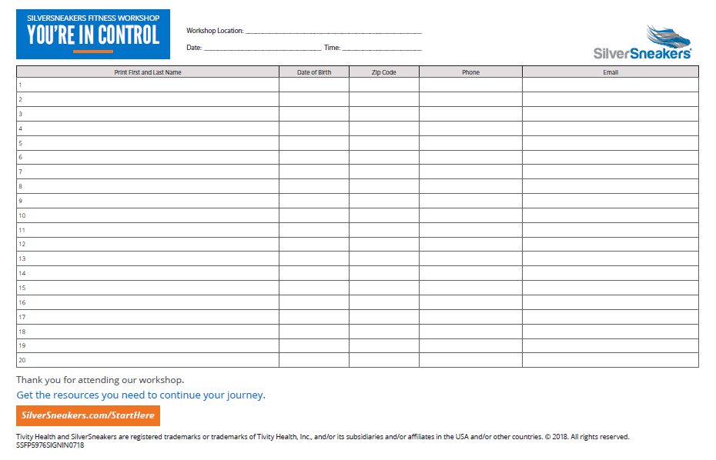
YOU’RE IN CONTROL Sign-in Sheet

Slide 5
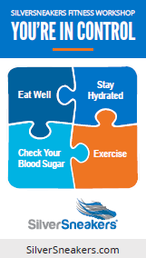
YOU’RE IN CONTROL Trackpad and Magnet

Slide 6
Event Preparation and Execution

Slide 7
YOU’RE IN CONTROL Event Schedule
Welcome: (5 minutes)
Greeting by PL Staff & SSFP Representative
Sign-in sheet completed & handed to PL staff for eligibility checks
Presentation: (20 minutes)
Introduction by Territory Manager/Program Champion
SSFP Fitness Workshop Presentation
Member eligibility checks to be conducted by PL staff during presentation; facility
enrollment packets prepared and sign-in sheets provided back to TM/PC
Physical Activity/Exercise: (30 minutes)
Led by Program Champion or Territory Manager
Wrap Up: (5 minutes)
Reminder of any take home information & next steps
PL staff to encourage location tours & make themselves available for enrollment

Slide 8
Event Facilitator Details

Slide 9
YOU’RE IN CONTROL Event Facilitator Resources
There are four main pieces you will use when facilitating the You’re In Control Workshop:
The Facilitator Guide
PowerPoint Slide Deck
Trackpad and Magnet

Slide 10
YOU’RE IN CONTROL Facilitator Guide
The Facilitator Guide is divided into two main sections.
The first section is Planning and Materials
This is a general outline, and you may determine that items should be added or deleted depending on the needs for your event

Slide 11
YOU’RE IN CONTROL Facilitator Guide
The second section is the Presentation Outline
This section provides you with information about what to say and when to say it
Talking points go along with a corresponding PowerPoint slide

Slide 12
YOU’RE IN CONTROL Trackpad and Magnet
During the presentation you will refer members to the Trackpad; Directions are noted in the Facilitator Guide
Encourage members to use the trackpad as a guide to tracking and celebrating their progress
SilverSneakers class counts for activity and first check mark
The magnet is a workshop anchor, or reminder, for members to make good choices daily on their health journey.

Slide 13
YOU’RE IN CONTROL Activity
After you have completed the presentation, you will lead the group through a 30 minute exercise activity outlined in the Facilitator Guide
For this presentation, this section includes a walking class
Simple to perform stepping exercises

Slide 14
YOU’RE IN CONTROL Closing
After completing the 30 minute activity section, you will follow the steps as outlined earlier:
Remind members about take home information & next steps
Encourage PL staff to make themselves available to complete enrollment and provide location tours

Slide 15
YOU’RE IN CONTROL Resources
Training
Training recording
Activity videos
Event Execution
Facilitator Guide
Workshop Toolkit with Marketing materials

Slide 16
Thank you

