Slide 1
SilverSneakers fitness Workshop You’re in Control
Exercise and Type 2 Diabetes
<Month/Date/Year>
<Presenters>
SSFP58480618
Notes:
Disclaimer: If you or a loved one has Type 1 Diabetes, exercise is still recommended but please speak to a health care professional before starting an exercise program.

Slide 2
SHARE YOUR EXPERIENCE
What are words you would use to described being diagnosed with Type 2 diabetes?

Slide 3
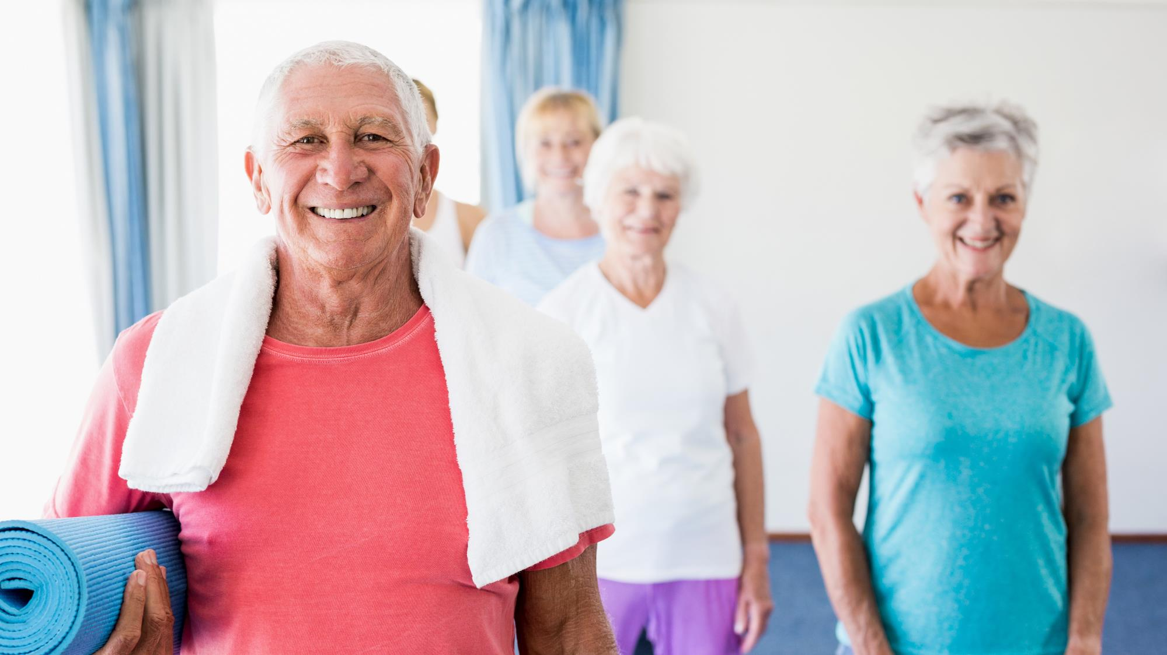
Good news! Living well with Type 2 diabetes is 99% self management.

Slide 4
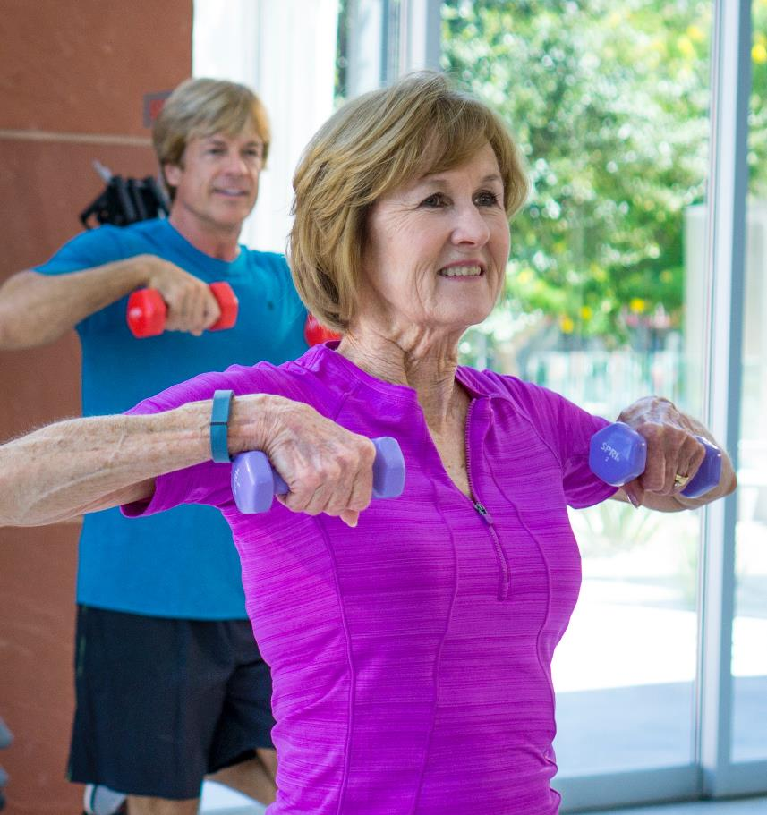
WHAT YOU’LL LEARN ABOUT TODAY
Managing Type 2 diabetes with exercise
Benefits of exercise and how it helps
Key features of SilverSneakers
Getting enrolled with SilverSneakers
Class demo

Slide 5
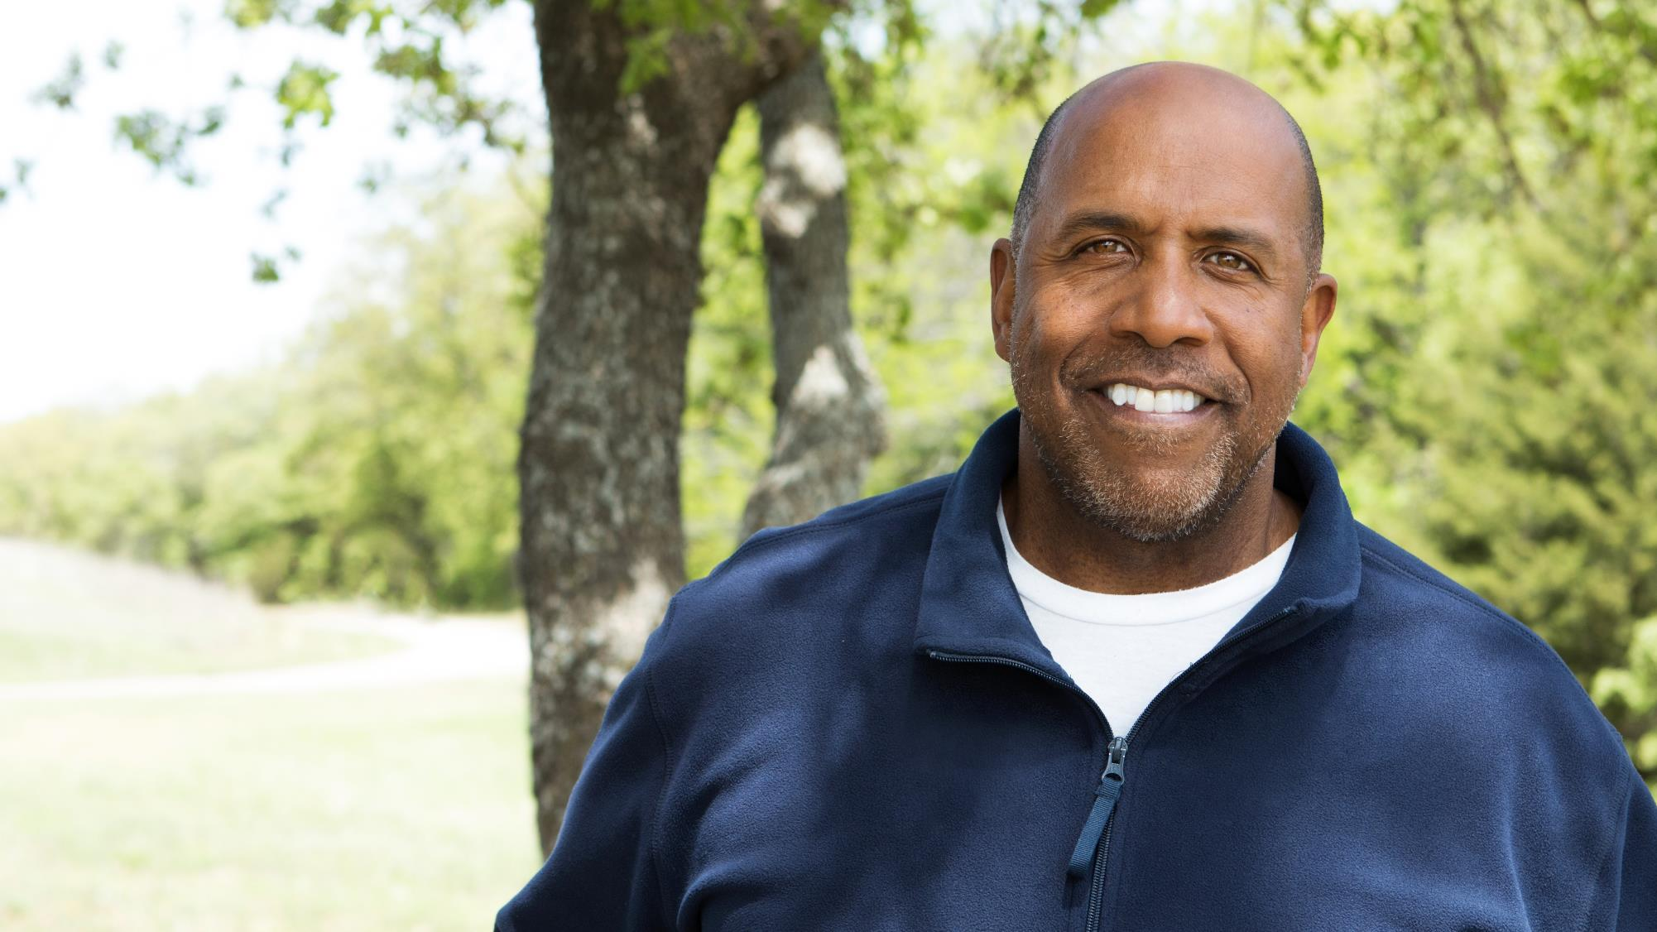
George, SilverSneakers member
“Several years ago, I was diagnosed with Type 2 diabetes. Through diet and exercise, I have been able to control the diabetes without medication.”

Slide 6
BENEFITS OF EXERCISE
Lower blood pressure.
Lower your risk for heart disease and stroke.
Burn calories to help you lose or maintain weight
Increase your energy for daily activities
Help you sleep better
Relieve stress

Slide 7
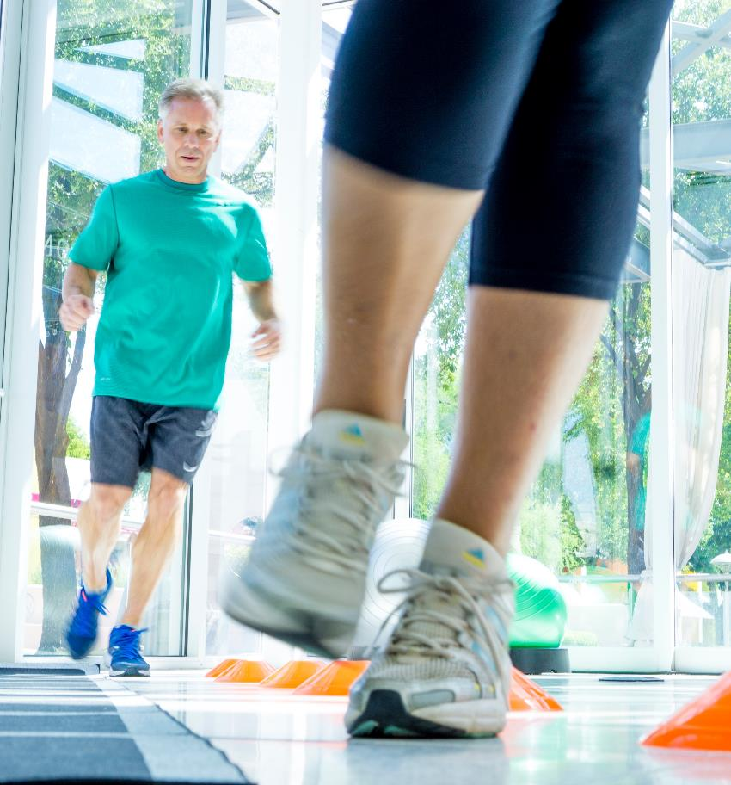
BENEFITS OF EXERCISE (Cont.)
Strengthen your heart and improve your blood circulation
Strengthen your muscles and bones
Keep your joints flexible
Improve your balance to prevent falls
Reduce symptoms of mild depression and improve quality of life

Slide 8
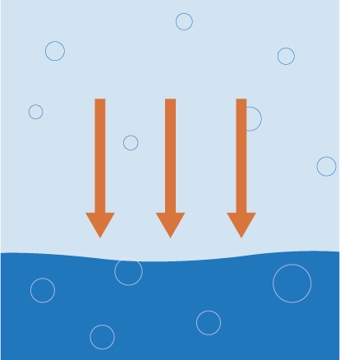
EFFECT OF EXERCISE ON TYPE 2 DIABETES
EXERCISE
People with Type 2 diabetes have too much glucose.
Exercise burns up blood sugar.
Exercise makes your body more sensitive to insulin.
The goal? Get enough physical activity to make it happen. (That’s where we come in).
GLUCOSE
https://www.endocrineweb.com/conditions/type-2-diabetes/type-2-diabetes-exercise

Slide 9
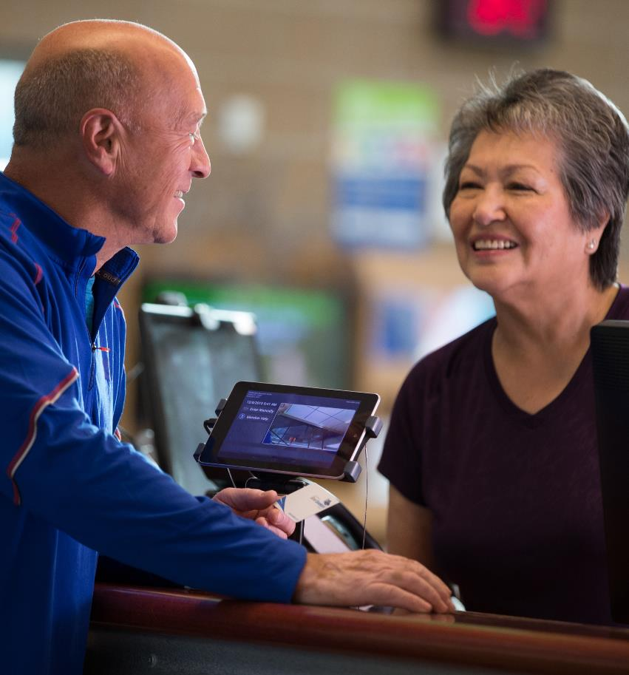
EXERCISE GUIDELINES
Check with your doctor.
Tell the gym.
Test your blood glucose levels.
Take your time.
Don’t do too much too quickly.

Slide 10
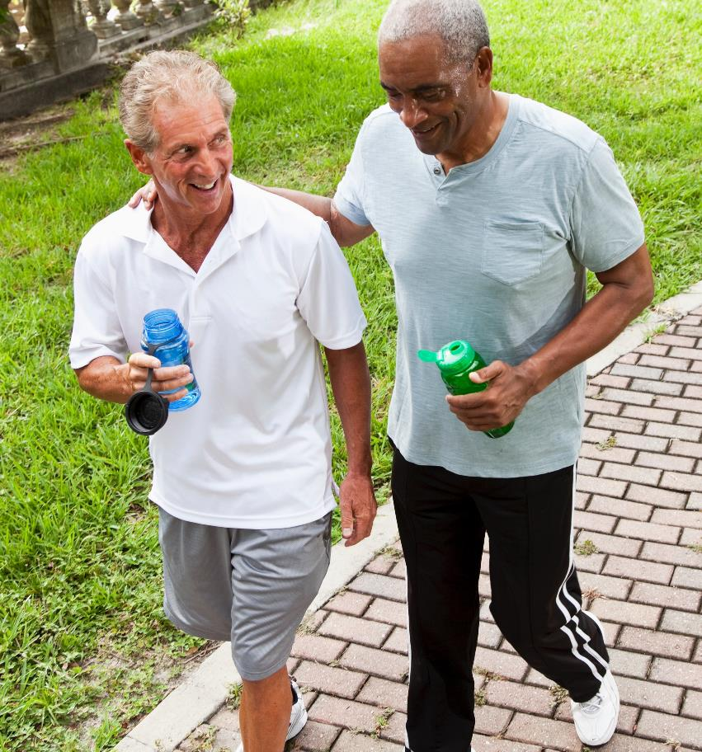
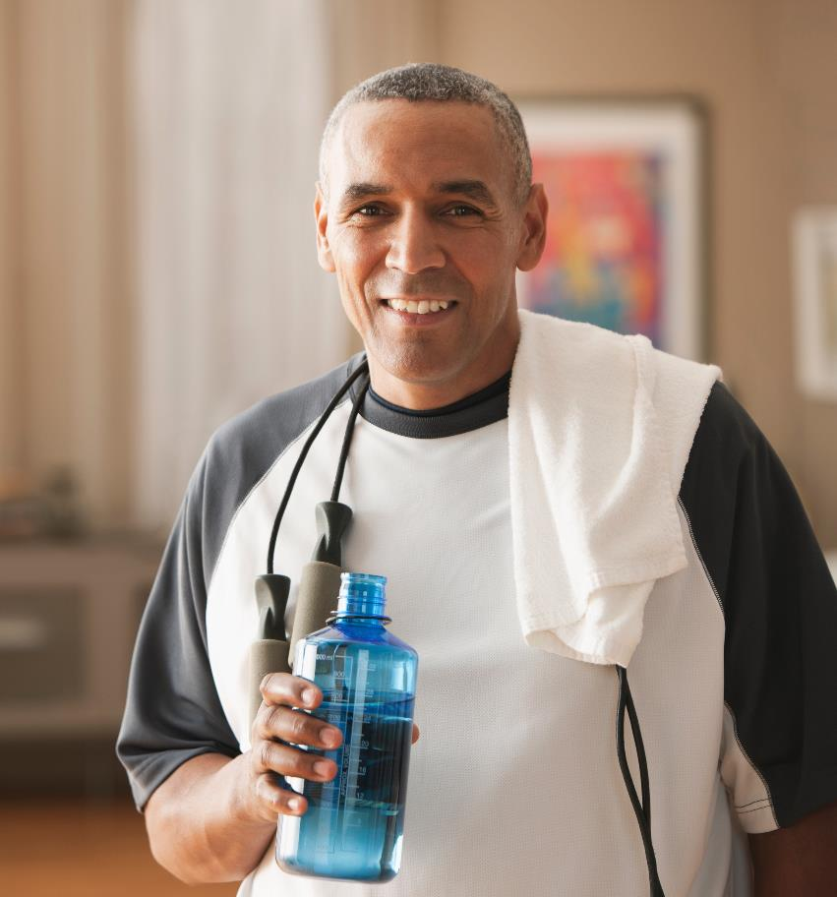
EXERCISE GUIDELINES (Cont.)
Drink plenty of fluids.
Be good to your feet.
Always wear athletic shoes during exercise.
Develop a strong support team.

Slide 11
SELF MANAGEMENT
Stay Hydrated
Eat
Well
EXERCISE
Check Your Blood Sugar

Slide 12
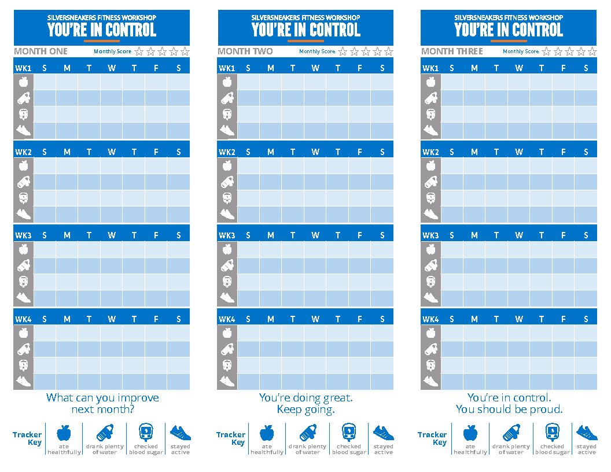
FORMING A HABIT
21 day rule
Intention is different than doing
Create environment to support your goal

Slide 13
YOUR SILVERSNEAKERS BENEFIT
Guidance and support
SilverSneakers FLEX classes
Equipment and other amenities
Online
SilverSneakers classes
Social events

Slide 14
LEARN MORE
SilverSneakers.com/StartHere
1-888-423-4632

Slide 15
IT’S TIME FOR CLASS

