Slide 1
SilverSneakers Fitness Workshop: The Happiness Effect Training Information

Slide 2
SilverSneakers Fitness Workshop: The Happiness Effect
The Happiness Effect is a new SilverSneakers Fitness Workshop launching in 2019, developed to help drive member enrollment and participation. It is a 45-60 minute workshop that educates members about how exercise and engaging in social settings can help with feelings of anxiety or loneliness.
OBJECTIVE
Help members understand the importance of exercise and building relationships with other people in improving mood.
STRATEGY
Lead members through a 15-20 minute workshop discussion booklet that helps them identify activities that make people feel good about themselves and the importance of making social connections. Follow with 30 minutes of light activity that accomplishes the goal of enrolling the member onsite at the workshop.
TARGET AUDIENCE
Eligible not enrolled members who live in key areas of opportunity to drive enrollment

Slide 3
Workshop Toolkit

Slide 4
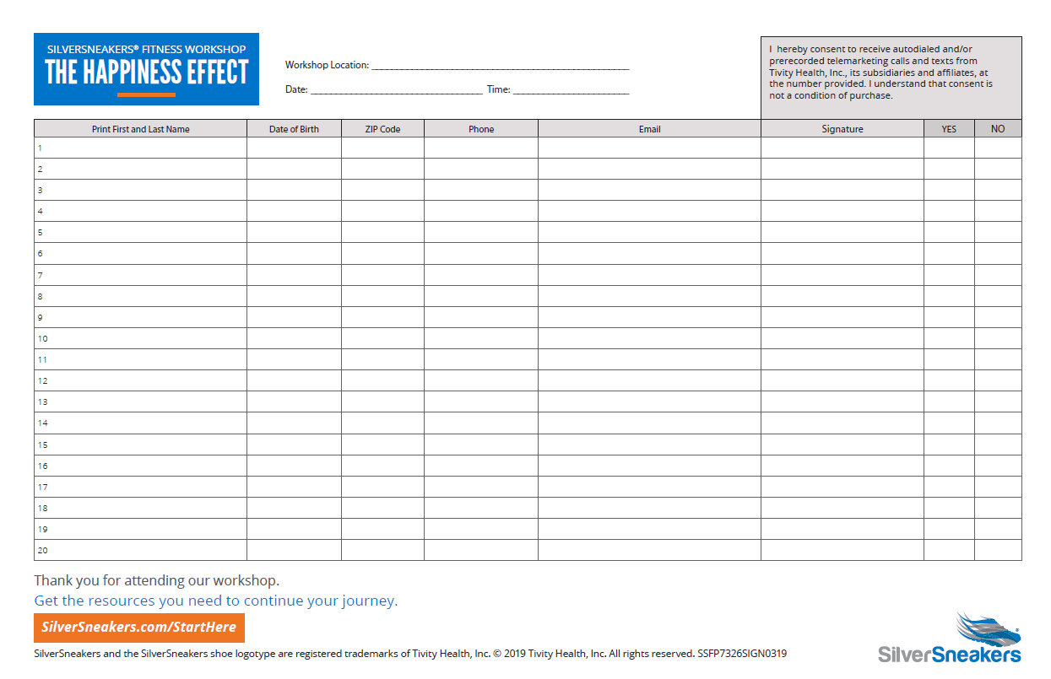
The Happiness Effect Sign-in Sheet

Slide 5
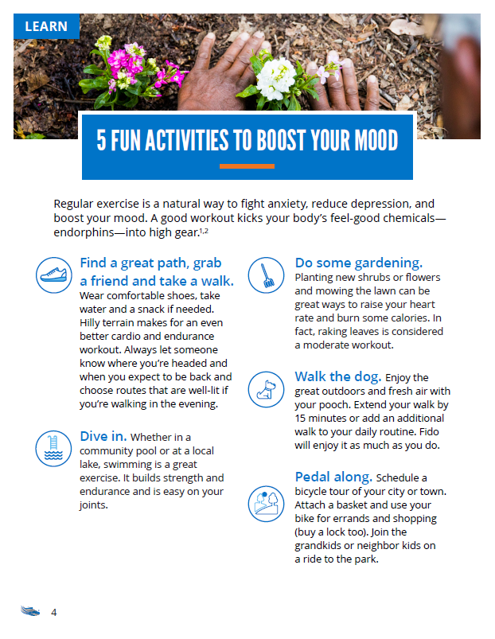
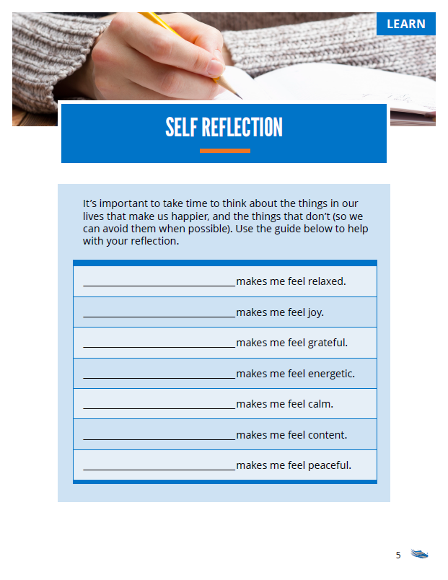
The Happiness Effect Member Workshop Booklet

Slide 6
Event Preparation and Execution

Slide 7
The Happiness Effect Event Schedule
Welcome: (5 minutes)
Greeting by PL and non-PL Staff & SS Representative
Sign-in sheet completed & handed to PL staff, TM, or PC for eligibility checks
Presentation: (20 minutes)
Introduction by Territory Manager/Program Champion
SS Fitness Workshop Presentation
Member eligibility checks to be conducted by PL staff or support staff during presentation; facility enrollment packets prepared and sign-in sheets provided back to TM/PC
Physical Activity/Exercise: (30 minutes)
Led by Program Champion or Territory Manager (Balance Builder only)
Wrap Up: (5 minutes)
Reminder of any take home information & next steps
PL staff to encourage location tours & make themselves available for enrollment
TM or IC to provide PL and FLEX options to members (non-PL locations)

Slide 8
Event Facilitator Details

Slide 9
The Happiness Effect Event Facilitator Resources
There are two main pieces you will use when facilitating the Happiness Effect workshop:
Workbook
Facilitator Guide
Choreography Document

Slide 10
The Happiness Effect Facilitator Guide
The Facilitator Guide is divided into two main sections.
The first section is Planning and Materials
This is a general outline and timeline. You may determine that items should be added, or deleted, depending on the event

Slide 11
The Happiness Effect Facilitator Guide
The second section is the Presentation Outline
This section provides you with information about what to say and when to say it
This presentation does not use a PowerPoint slide deck, and you’ll notice that not every page in the workbook has talking points

Slide 12
The Happiness Effect Workbook
This presentation calls on you to facilitate a discussion around the health benefits of exercise and strong relationships
The Workbook is used in conjunction with the Facilitator Guide to lead through information and exercises
Workbook pages are listed next to the talking points in the Facilitator Guide

Slide 13
The Happiness Effect Workbook
The workbook also includes sample at-home exercises
Include a variety of exercises for strength, balance, and flexibility
These are a nice resource for people who don’t know where to start or are looking for new ideas

Slide 14
The Happiness Effect Activity
After you have completed the discussion and activity, a PC will lead the group through a 30 minute exercise activity outlined in the Facilitator Guide
For this presentation, this section is a mindful stretching class
A Word doc is available for written choreography and a video of the class is available for training purposes

Slide 15
The Happiness Effect Closing
After completing the 30 minute activity section, you will follow the steps as outlined earlier:
Remind members about take home information & next steps
Encourage PL staff to make themselves available to complete enrollment and provide location tours

Slide 16
Thank you

