Slide 1
SilverSneakers Fitness Workshop:
A Little Means A Lot
Training Information

Slide 2
SilverSneakers Fitness Workshop:
A Little Means A Lot
A Little Means A Lot is one of three new SilverSneakers Fitness Workshops launching in 2018, developed to help drive member enrollment and participation. It is a 45-60 minute workshop that educates members about how small increases in physical activity can add up and lead to positive, healthy results.
OBJECTIVE
Help members understand the importance of taking small steps towards better health through self-reflection, setting a small goal, developing a plan to achieve it, and getting active
STRATEGY
Lead members through a 15-20 minute workshop discussion booklet that helps them identify a fitness goal and develop a plan with small steps towards achieving it.
Follow with 30 minutes of light activity that accomplishes the goal of enrolling the member onsite at the workshop.
TARGET AUDIENCE
Eligible not enrolled members who live in key areas of opportunity to drive enrollment

Slide 3
Workshop Toolkit

Slide 4
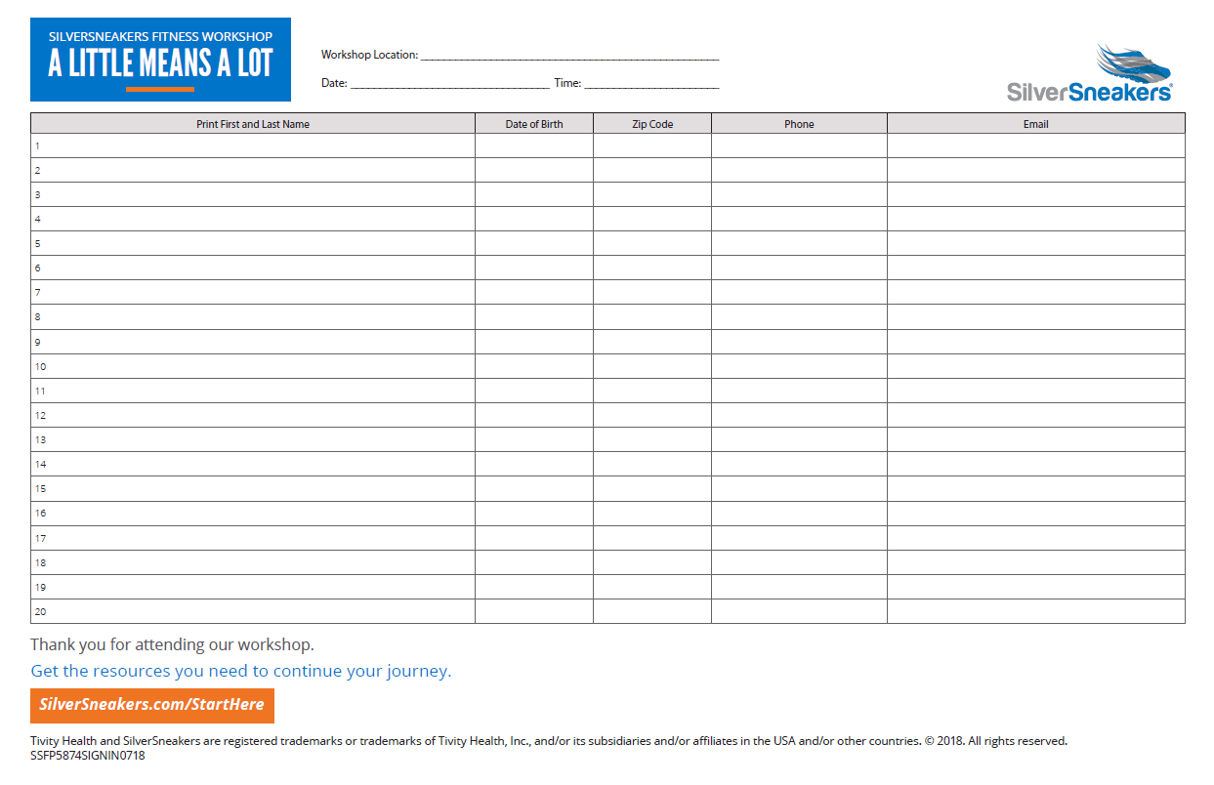
A LITTLE MEANS A LOT
Sign-in Sheet

Slide 5

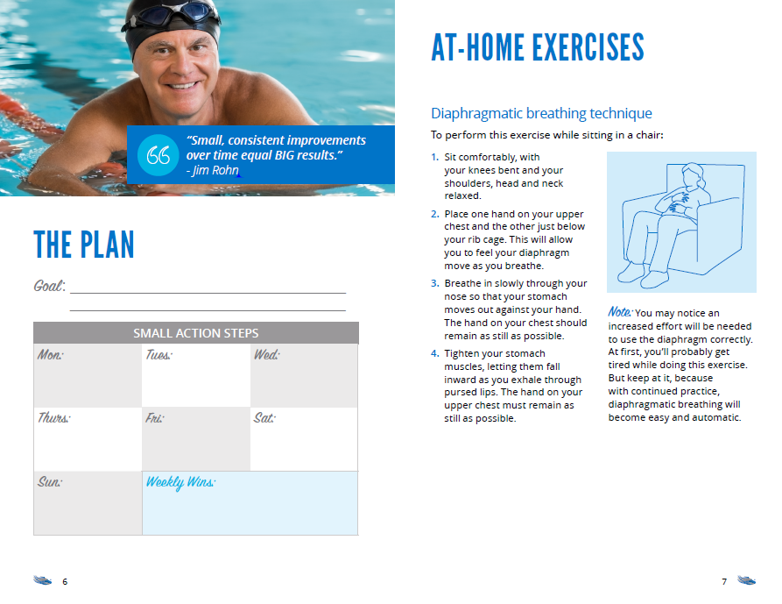

A LITTLE MEANS A LOT
Member Workshop Booklet

Slide 6
Event Preparation and Execution

Slide 7
A LITTLE MEANS A LOT
Event Schedule
Welcome: (5 minutes)
Greeting by PL Staff & SSFP Representative
Sign-in sheet completed & handed to PL staff for eligibility checks
Presentation: (20 minutes)
Introduction by Territory Manager/Program Champion
SSFP Fitness Workshop Presentation
Member eligibility checks to be conducted by PL staff during presentation; facility
enrollment packets prepared and sign-in sheets provided back to TM/PC
Physical Activity/Exercise: (30 minutes)
Led by Program Champion or Territory Manager
Wrap Up: (5 minutes)
Reminder of any take home information & next steps
PL staff to encourage location tours & make themselves available for enrollment

Slide 8
Event Facilitator Details

Slide 9
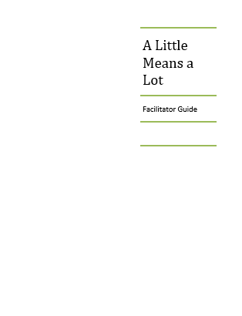
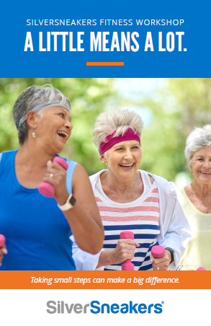
A LITTLE MEANS A LOT
Event Facilitator Resources
There are two main pieces you will use when facilitating the A Little Means A Lot Workshop:
The Facilitator Guide
Workbook

Slide 10
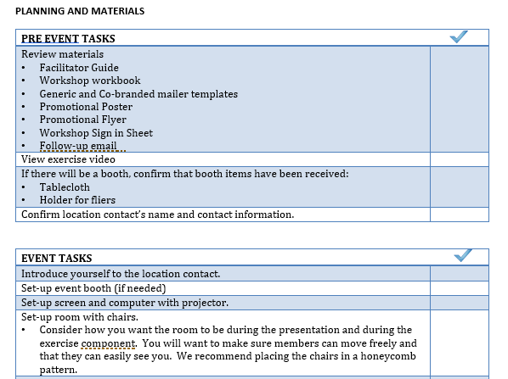
A LITTLE MEANS A LOT
Facilitator Guide
The Facilitator Guide is divided into two main sections.
The first section is Planning and Materials
This is a general outline, and you may determine that items should be added or deleted depending on the needs for your event

Slide 11
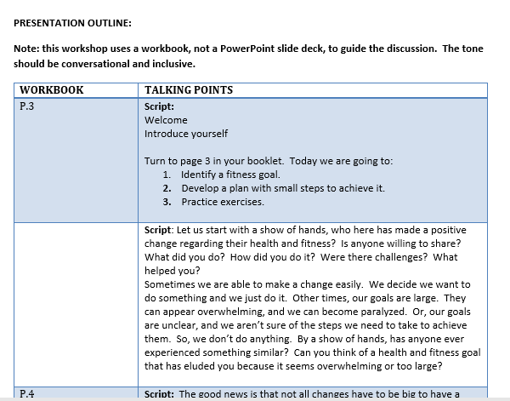
A LITTLE MEANS A LOT
Facilitator Guide
The second section is the Presentation Outline
This section provides you with information about what to say and when to say it
This presentation does not use a PowerPoint slide deck, so you’ll notice that not every page in the workbook has talking points

Slide 12
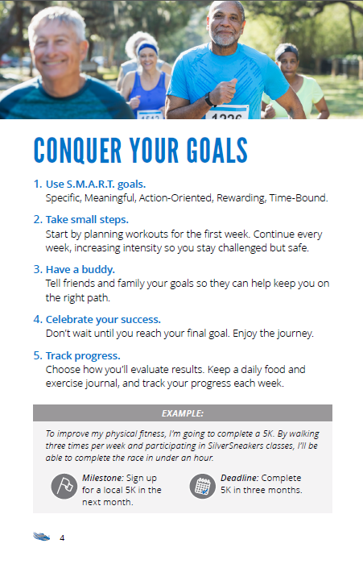
A LITTLE MEANS A LOT
Workbook
This presentation calls on you to facilitate a discussion around goal planning
The Workbook is a discussion guide that leads the group through goal setting and planning exercises
There is an example in the Workbook for you to refer to during this exercise

Slide 13
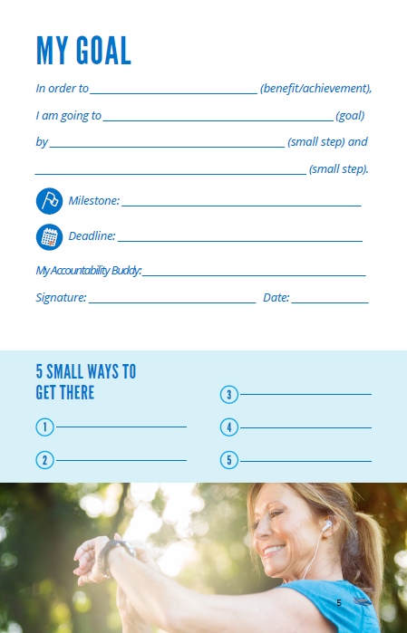
A LITTLE MEANS A LOT
Workbook
Specifically, you will walk members through the process of identifying a goal and breaking it down into small, achievable steps
The Facilitator Guide walks you through what to say to lead the activity

Slide 14
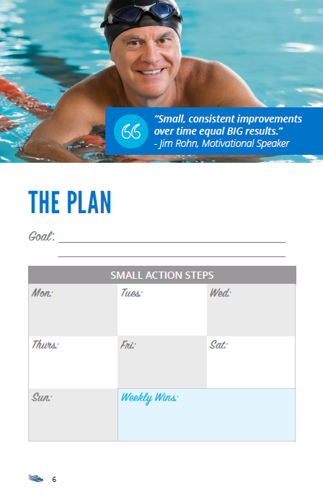
A LITTLE MEANS A LOT
Workbook
Next, each member will take the information they have provided in the previous section and enter in into The Plan section
This section is designed to help them take action by attaching a date and a visual reminder
They are creating their plan for the first week

Slide 15
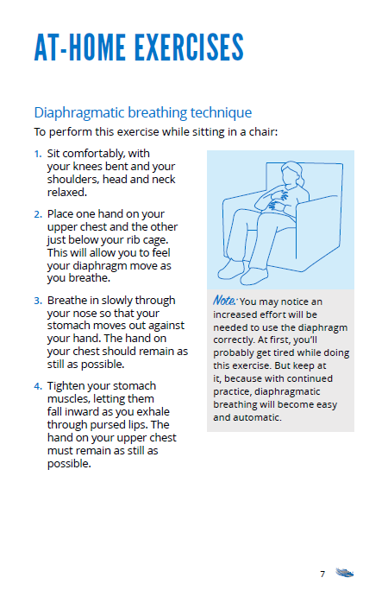
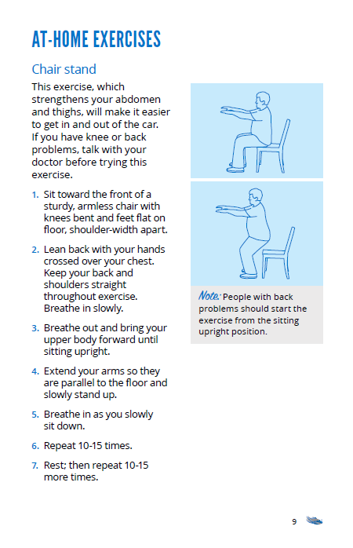
A LITTLE MEANS A LOT
Activity
After you have completed the goal setting activity, you will lead the group through a 30 minute exercise activity outlined in the Facilitator Guide
For this presentation, this section includes a broad range of exercises that members can do almost anywhere
Some of these exercises are presented in the Workbook for members to refer to later

Slide 16
A LITTLE MEANS A LOT
Closing
After completing the 30 minute activity section, you will follow the steps as outlined earlier:
  Remind members about take home information & next steps
  Encourage PL staff to make themselves available to complete enrollment and provide location tours

Slide 17
A LITTLE MEANS A LOT
Resources
Training
Training recording
Activity videos
Event Execution
Facilitator Guide
Workshop Toolkit with Marketing materials

Slide 18
Thank you

